Slide 1
Lesson 2: Invest P1: What are some Low/Med/High Risk Investments P2: Personal Rules for Investing P3: Value of Time

Slide 2
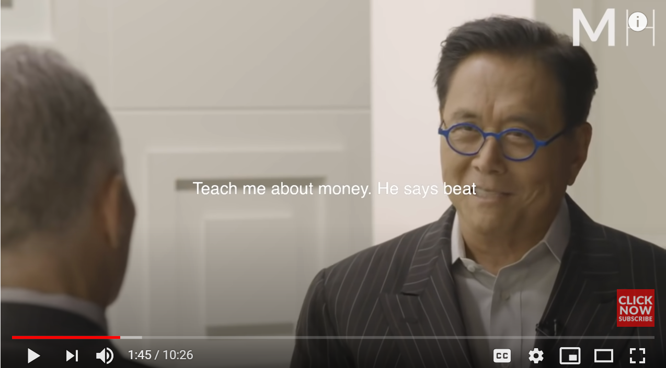
Q: Why am I teaching you to Invest?
Our school system does not teach about money
I feel the obligation to share what I know hoping that it will make a difference in your life
I don’t believe that life is about money but learning how to manage it will free up our time to do what is important
Constant worry about money can consume you or create unnecessary stress
Not trying to be rich but be better stewards of what we have
I agree that our school system should spend more time teaching kids to manage their finance.
I disagree that our school system is about teaching to be an employee.
School – learn to think, skills, values to make this world a better place
“Keep them Poor”
Robert Kiyosaki on why schools don’t teach about money

Slide 3
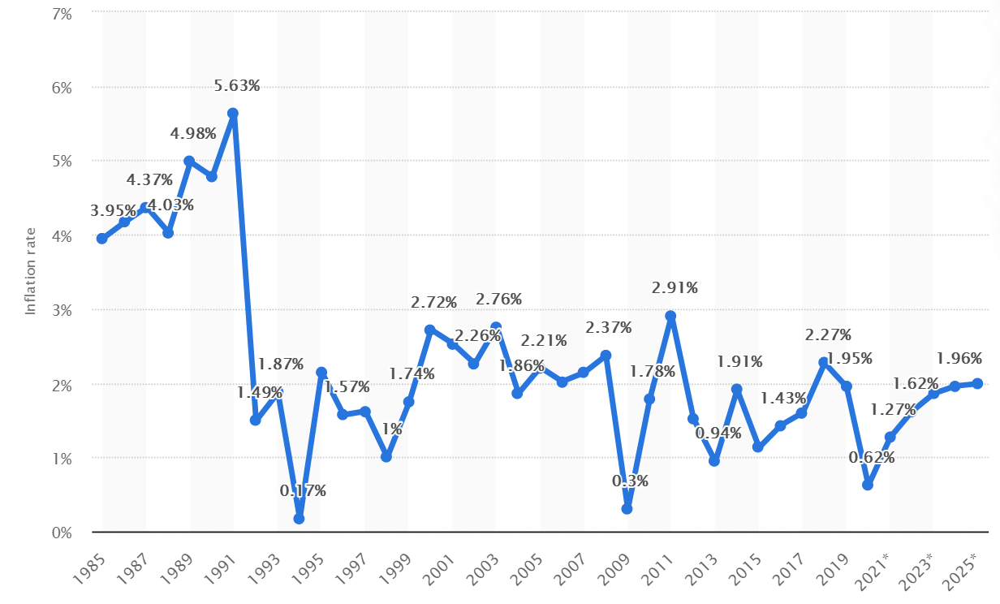
WHY INVEST?
Simple Answer :Inflation – the decline in purchasing power of a currency over time
The cost of commodities increase over time, the value of dollar will decrease

Slide 4
I) Different Types of Investments
Most investments have risks
Big returns → Big Risks, Small returns → lower risk
Short term → High risk (gambling)
Long Term → Lower risk (investing), value of time to offset the risk of market fluctuations
Low Risk
Fixed Income Investments – Put money in bank, gain interest
Ie: GIC, Savings Account (Simple Interest)
Medium Risk
Mutual Funds, Bonds, Segregated funds
Buy an investment portfolio that is managed by professionals that charge you a small fee/commission
Higher Risk
Self directed investment through a trading account
Stocks and ETF’s

Slide 5
ii) LOW RISK: Savings Account & GIC
If you have a low tolerance for risk → GIC
GIC : Guaranteed Investment Certificate – a low interest investment, where money is locked in exchange for a guaranteed fixed percentage.
Ie: RBC offers 1% interest on a 1 year term, 1.3% on 2yrs, etc
Advantages:
Low risk
Disadvantages:
Low return, most bank offer very low interest rates
Money is locked in, can’t take out until the term matures, otherwise, you won’t earn any interest
Note: a 1% return may seem like very little. However, what’s worse is keeping your money in an savings/chequing account with little or almost no interest!
What is a GIC?

Slide 6
Simple Interest I = P x R x T
I: Interest earned or charged P: Principal
R: Interest Rate in percentage T: Time (in years)
Ex: TD offers different interest rates for 100 days, 1 year and two years. If Anna invests $20,000 for 2 years for either GIC’s, how much money will she earn interest?
i) 2 years (1.3%) ii) 1 year (0.95%) iii) 100 days (0.20%)

Slide 7
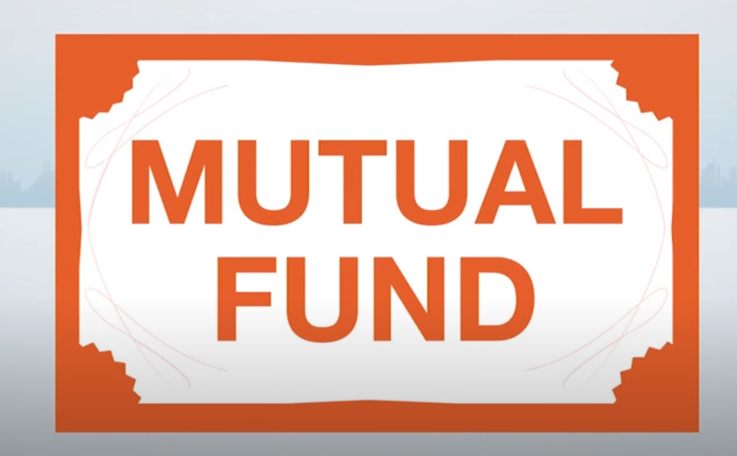
Medium Risk: Mutual Funds (MF)
A (MF) is a type of investment made up of stocks, bonds, money market instruments, and other assets.
Pros – allows small investors to buy into a diversified market
Cons – management fees can be high (2% or 3%)
Management fees are based on the amount of the principal
Pay Management Fees despite whether they make/lose money
Management fees can add up!
Some financial advisors are bad (marketplace)
Video on mistakes that financial advisors make
What is a Mutual Fund: Basics in Investing
What are Bonds?

Slide 8
Ex: Sandy bought 2000 shares of a World Diversified Fund at $23 per share. The WDF increased in value at 5%, 8%, and 12% each year. If the management fee is 2%, how much will her invest be valued after 3 years?

Slide 9
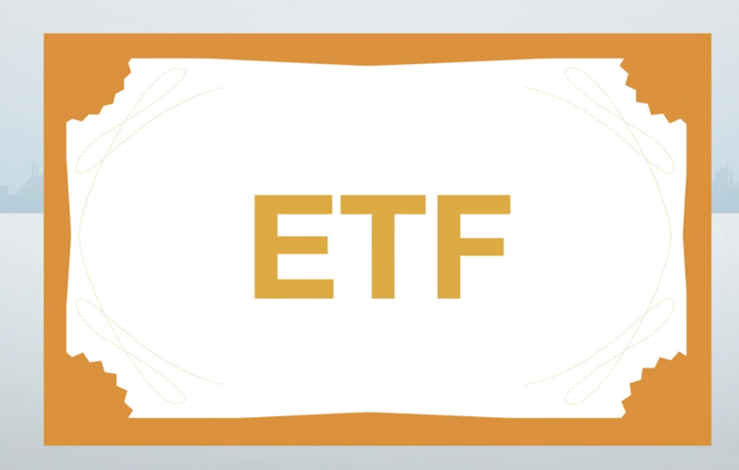
What are ETF’s?
ETF’s (exchange traded fund) (Index funds)
A fund that contains different stocks, bonds, and commodities
Funds can be in a lot of similar market stocks
Low management fee (less than mutual funds)
Traded like a stock but lower risk because of diversification
Can be traded in real time, unlike MF that are traded at the end of the day
Not actively managed but follows a formula on which stocks to buy or sell, managed by professionals
ETF’s vs Mutual Funds Which is Better?
What are ETF’s? Basics in Investing
Explains the general difference b/n ETF’s and MF

Slide 10
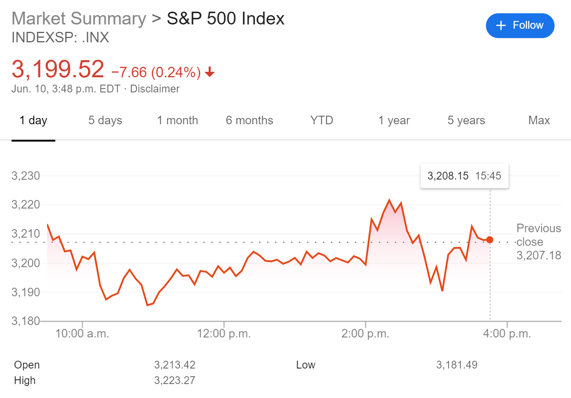
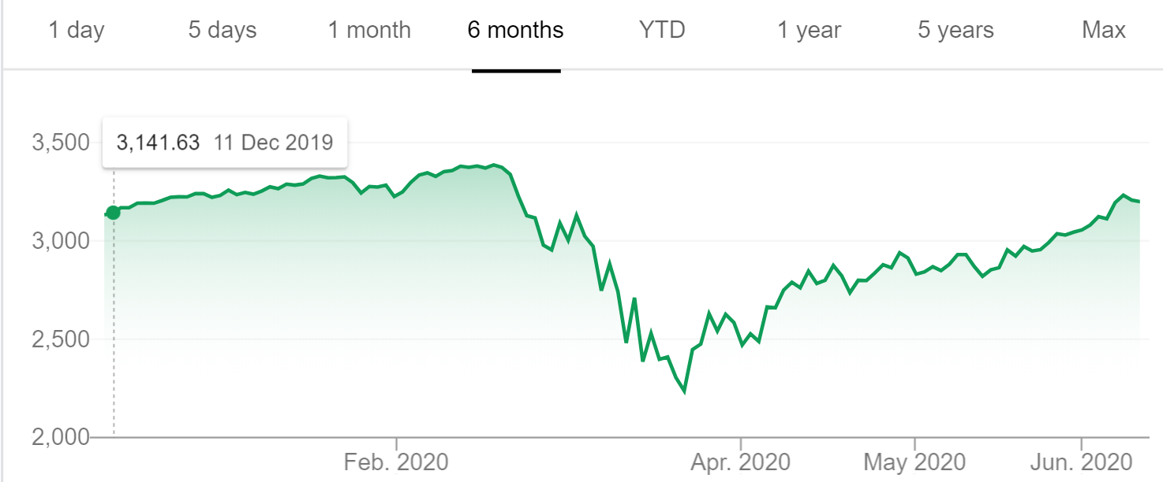
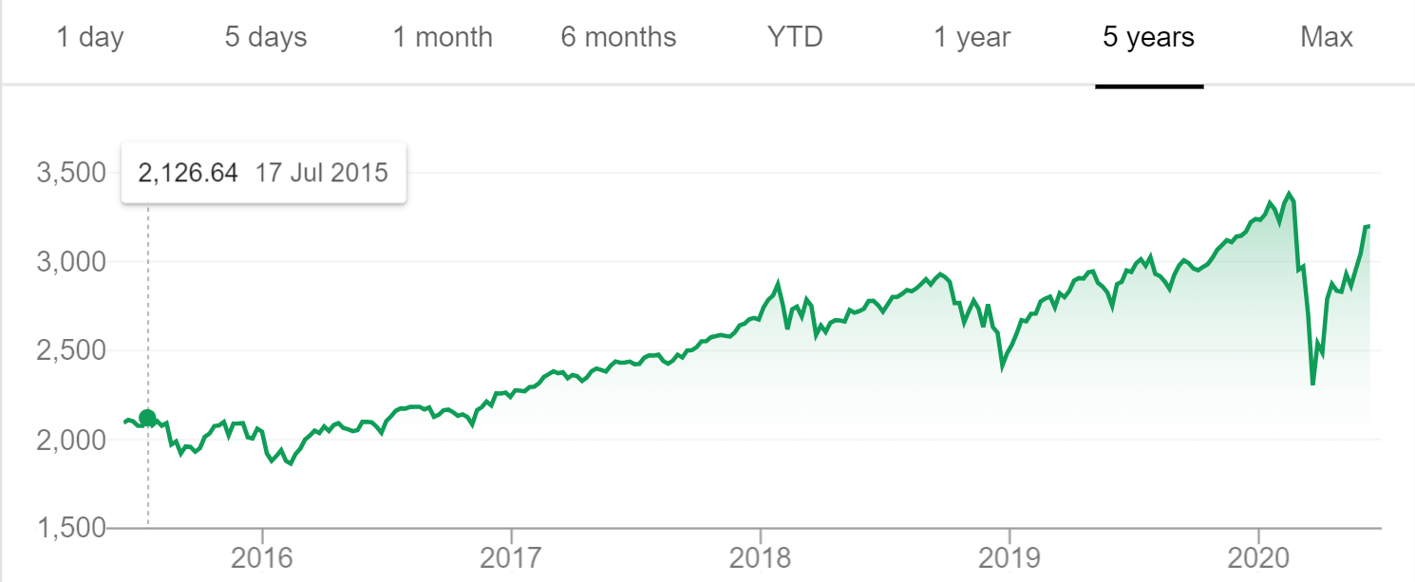
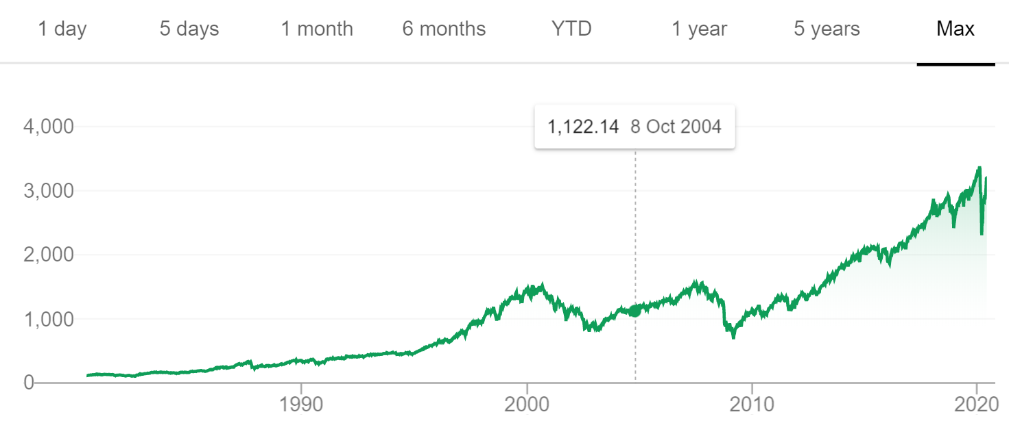

Slide 11
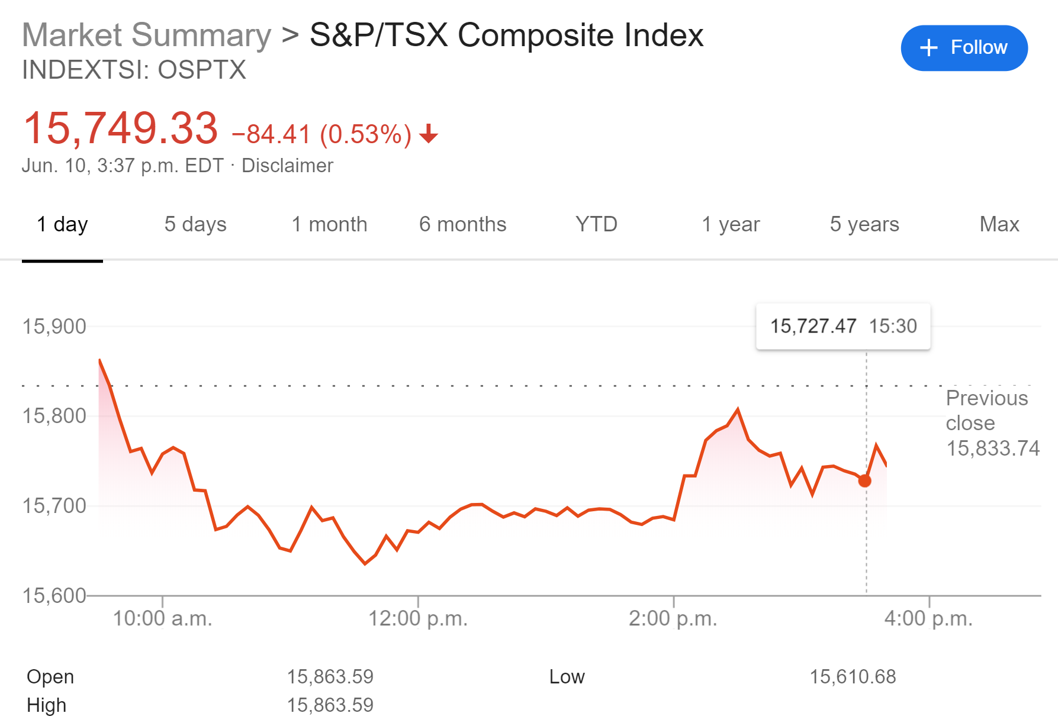
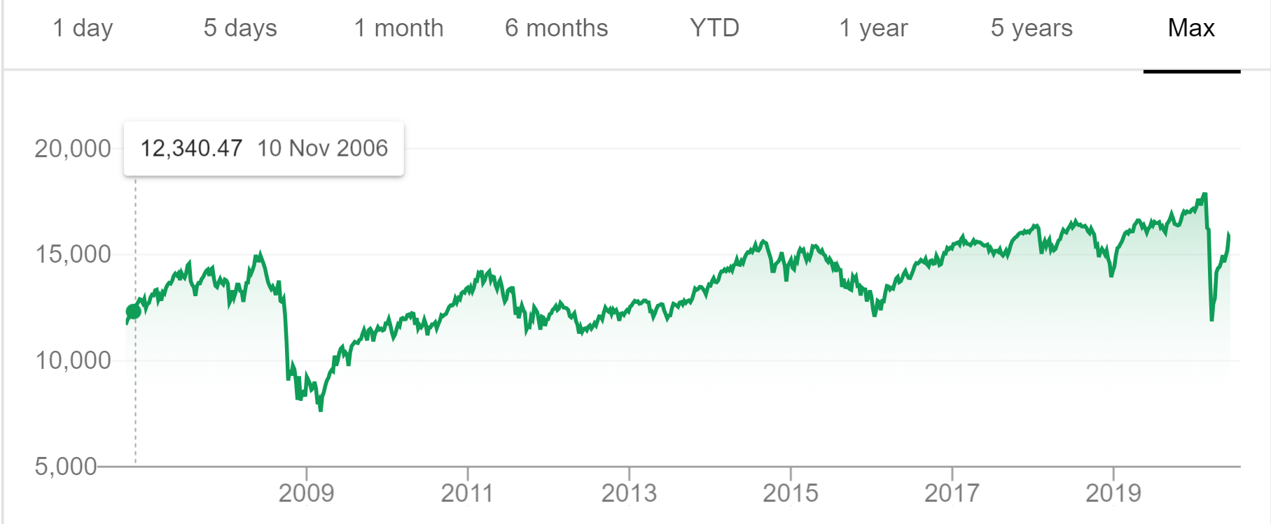
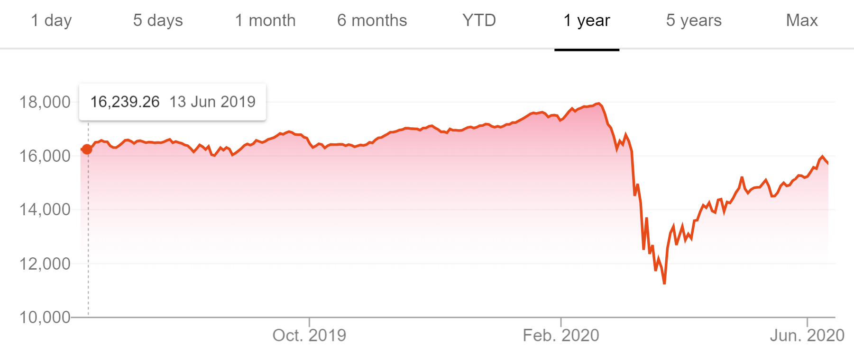
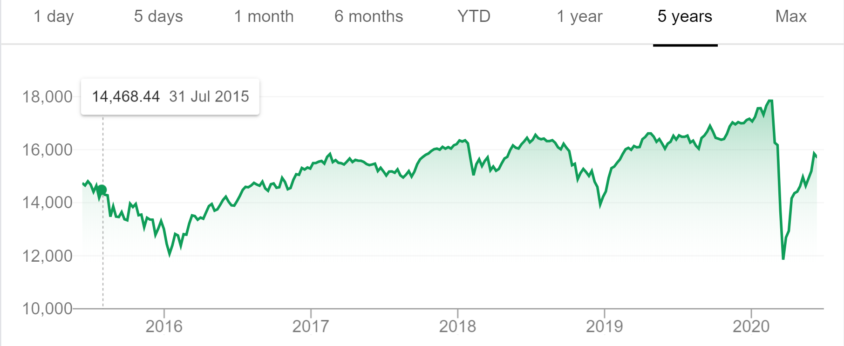

Slide 12
Higher Risks: Stocks
Stocks are higher in risk because of it’s volatility and self directed
Each stock is a partial ownership of a company
Money is made through appreciation and dividend
BUY low and sell high
Dividends: Money paid to shareholders (every 3 months) from profits
Each time a trade is made (Buy or Sell) there is a cost
STOCKS
What are Stocks? Basics in Investing

Slide 13
Personal Rules
Pick stocks with a low P/E ratio (price to earning ratio)
Ie: Value of the stock divided by the company’s earnings
High Volume (stocks that are traded often, easier to sell)
Net value of company is at least 1 Billion
Don’t buy small companies → Greater risk of bankruptcy
Buy into sectors that will be around for many years
Banks, Oil, Retail, things that will be around for the next 10/20 years
Diversify – USA/CAD market,
Don’t day trade – can’t beat the market, short term trading is very risky (gambling),
small percentage of day traders make money (10%)
No one can predict the market, so don’t try to do that, instead invest long term
Only invest in what you can afford to lose
In general, you buy, you wait for awhile until the value goes up
Don’t let the daily ups & downs affect you

Slide 14
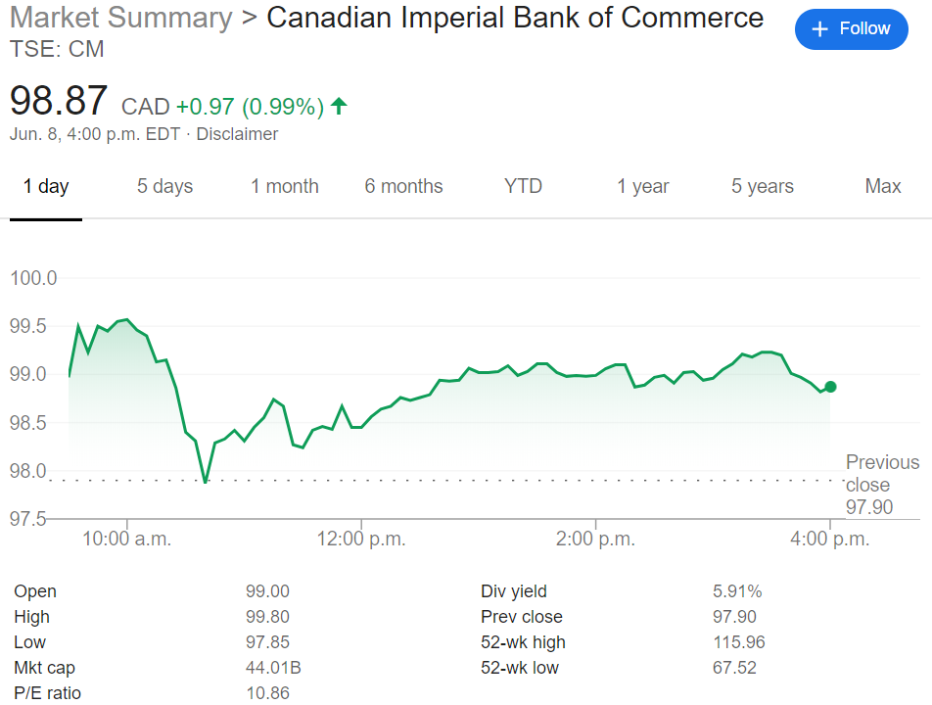
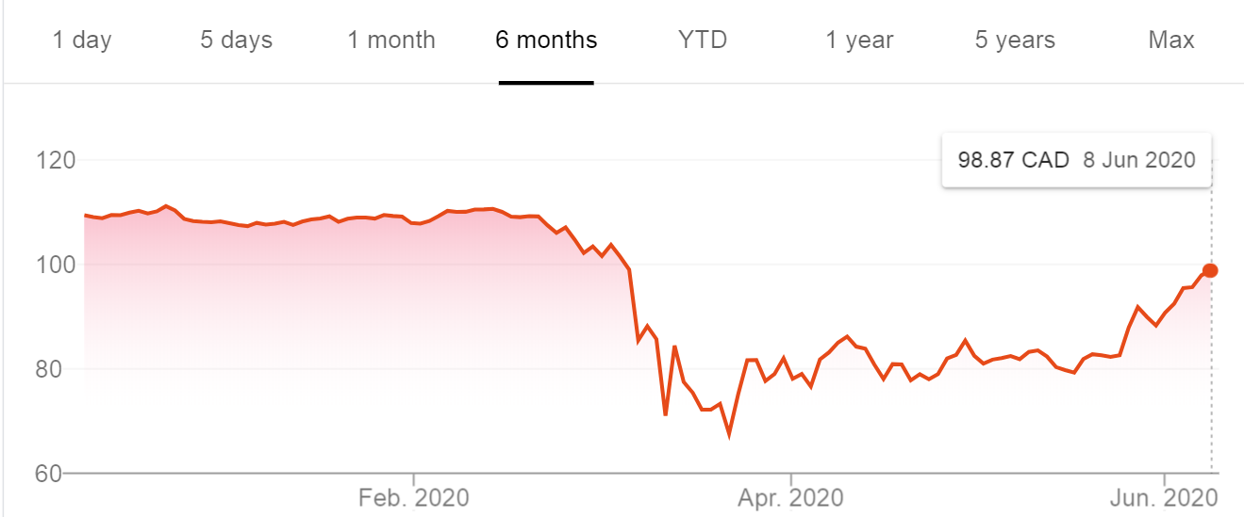
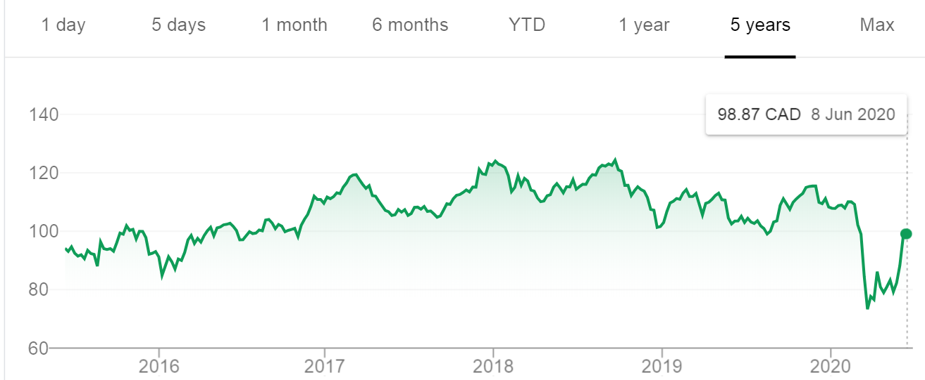
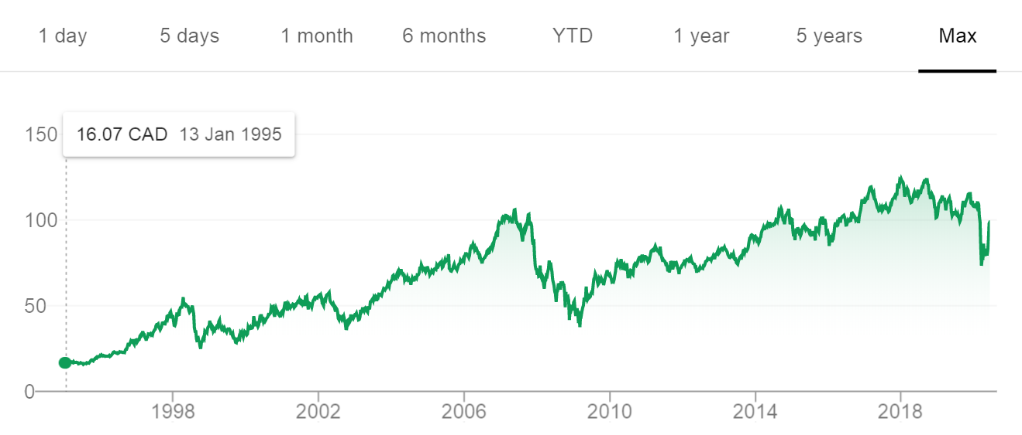

Slide 15
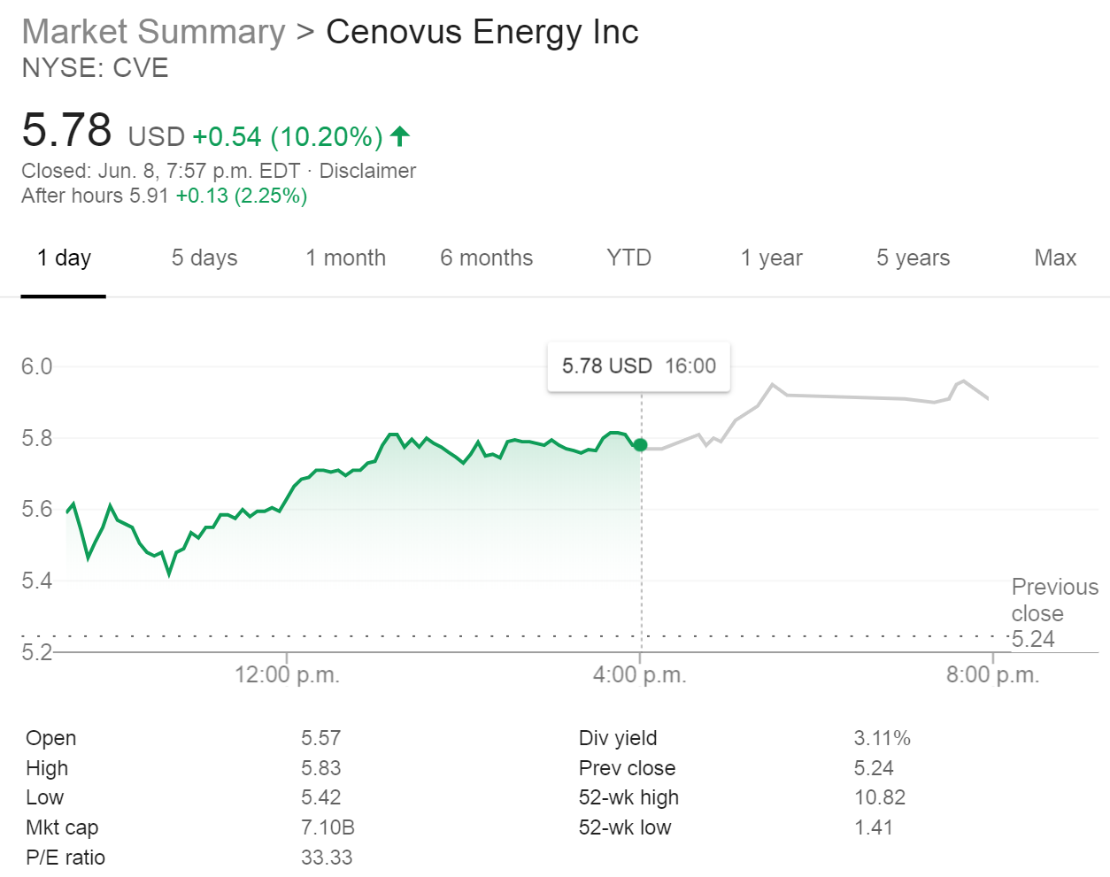
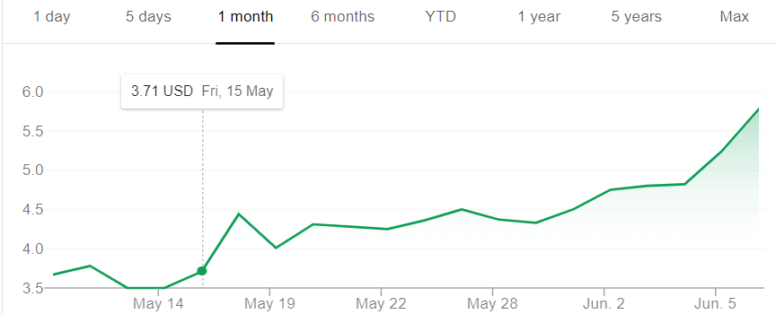
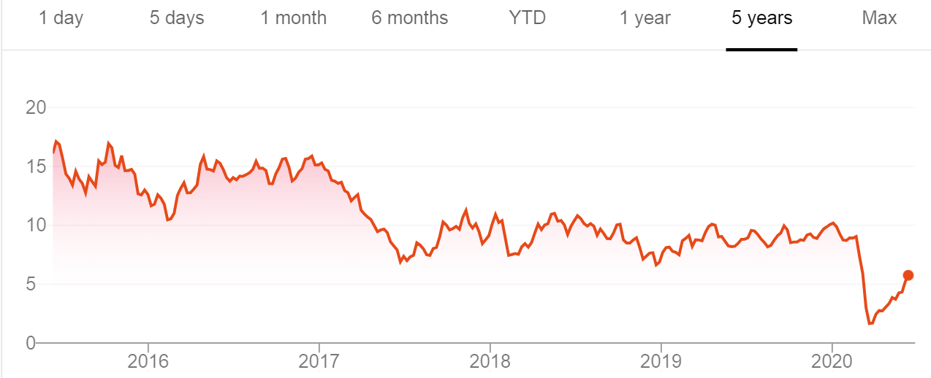
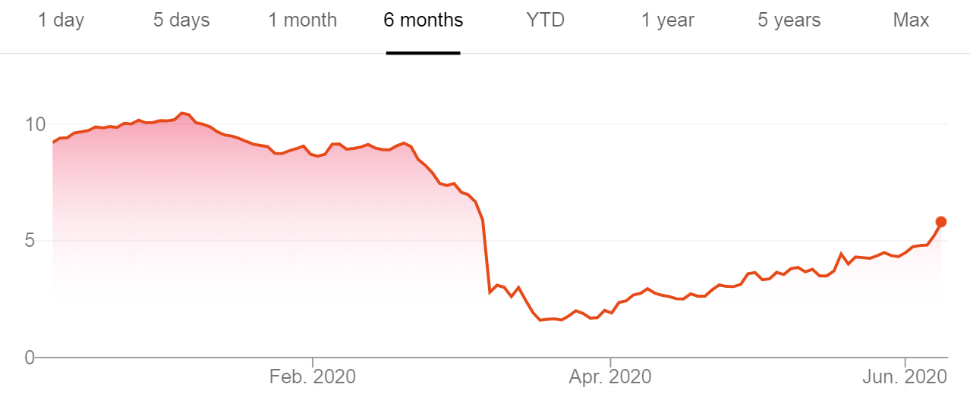

Slide 16
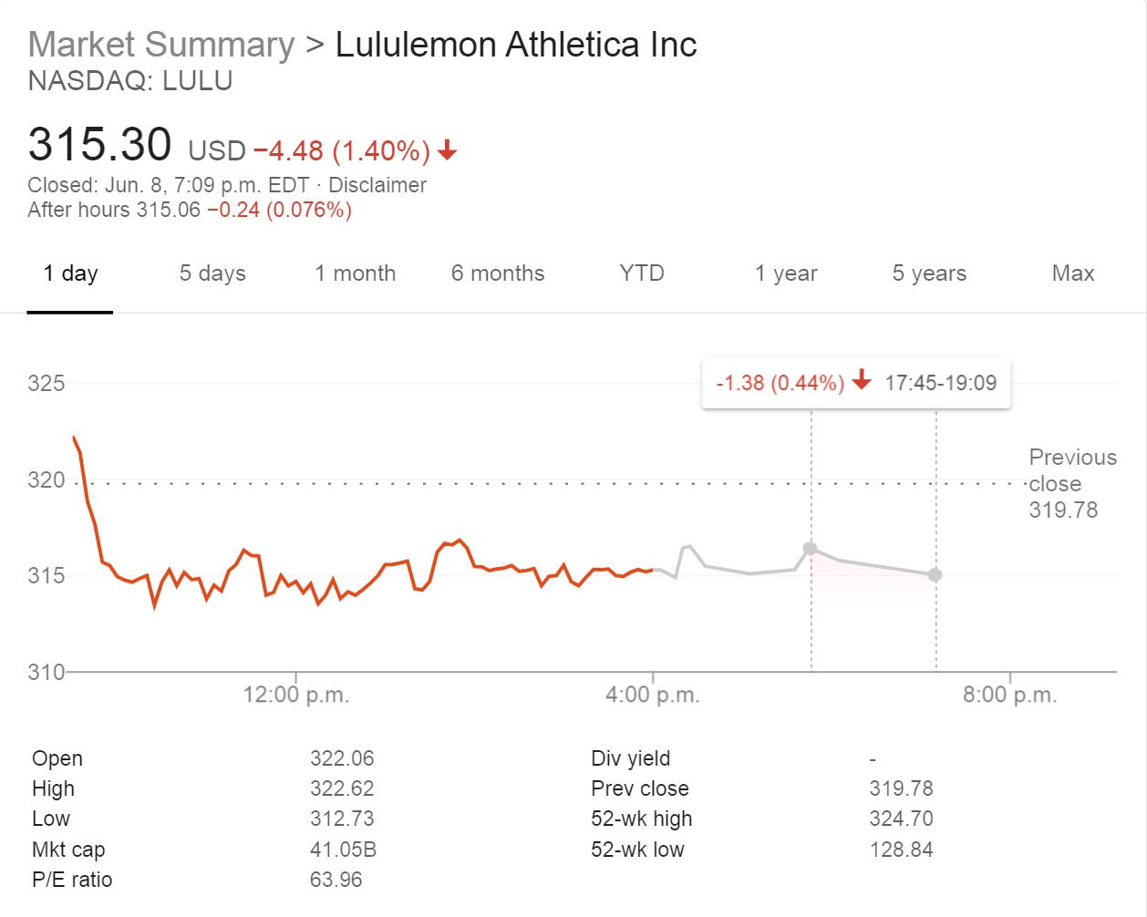
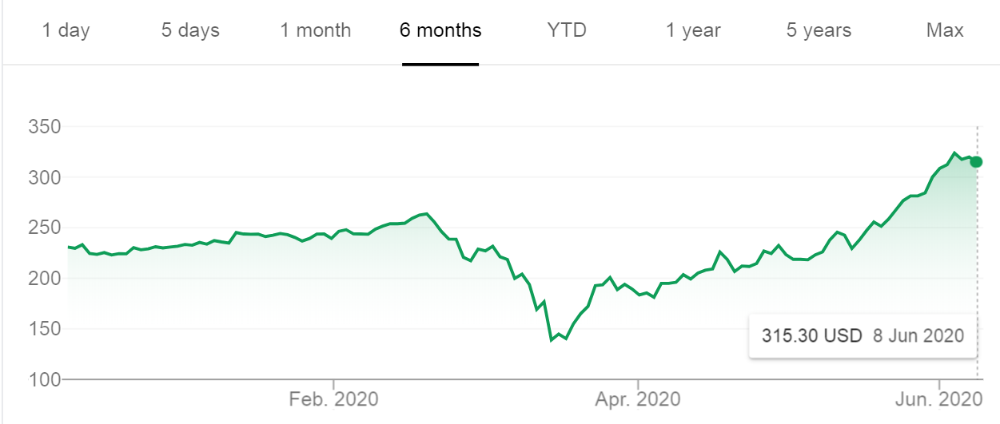
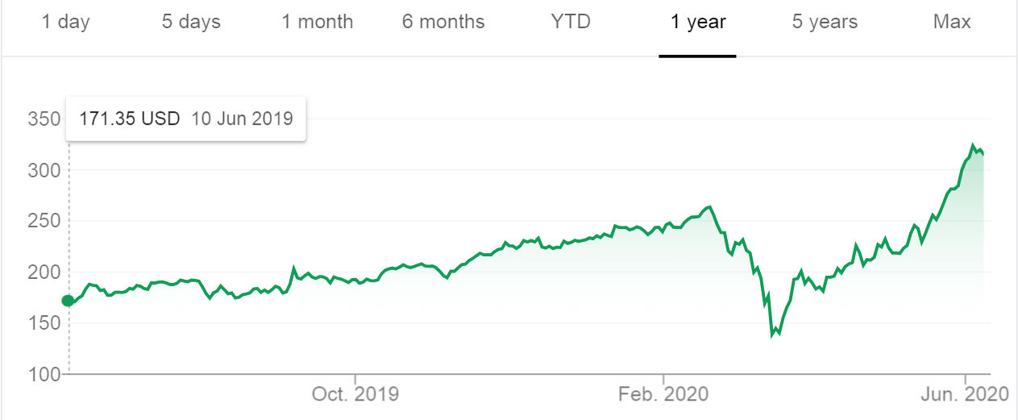
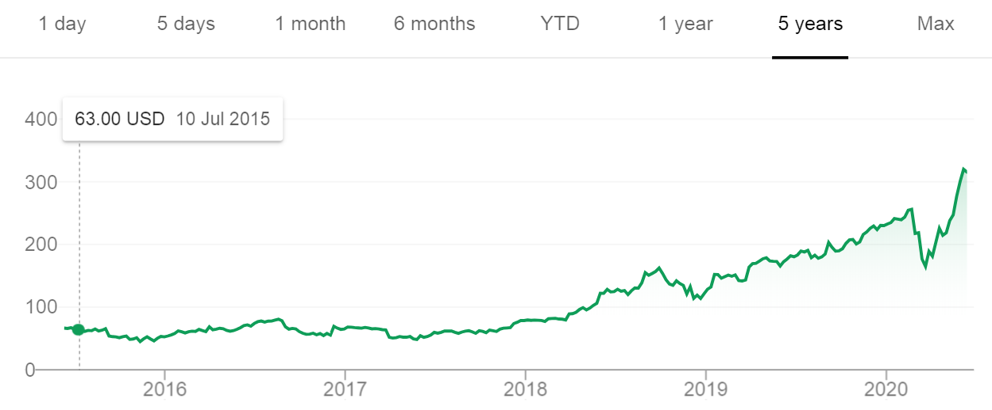
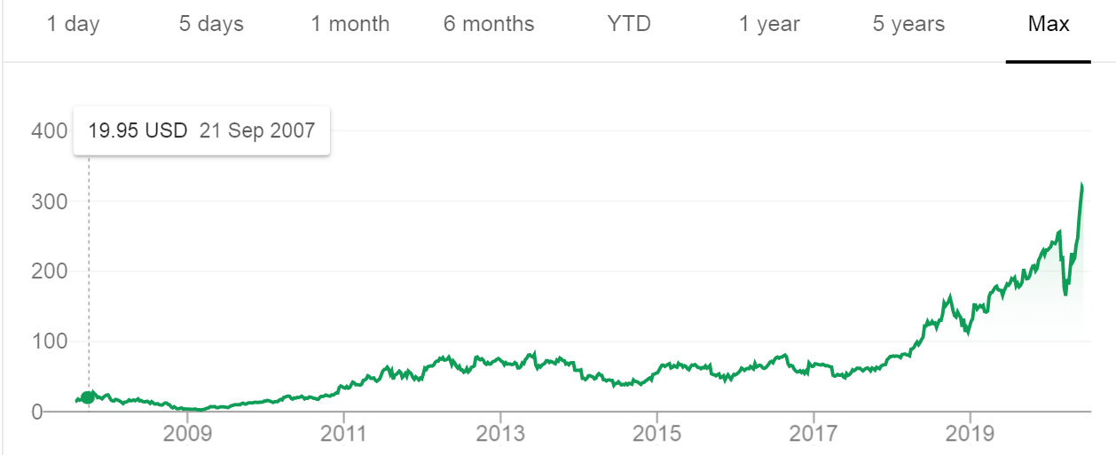

Slide 17
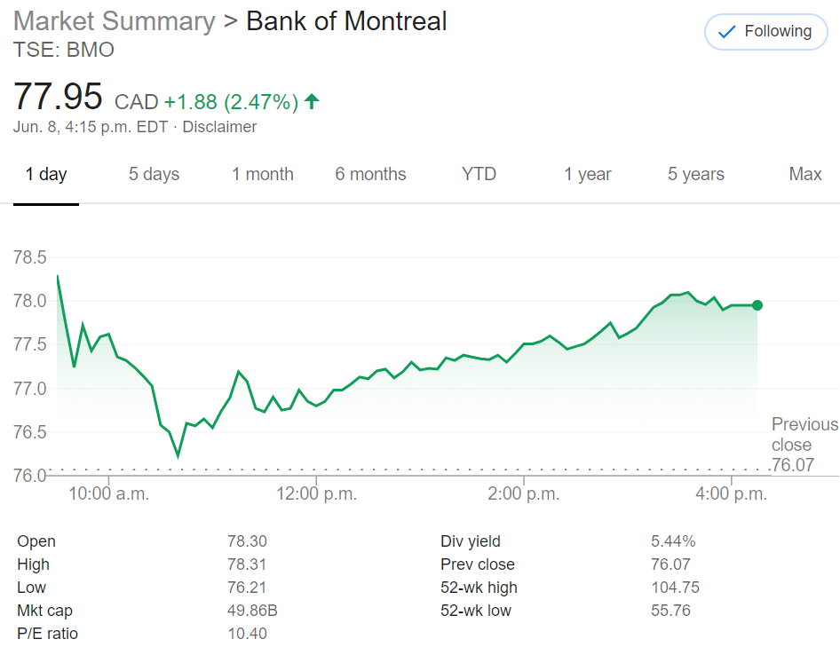
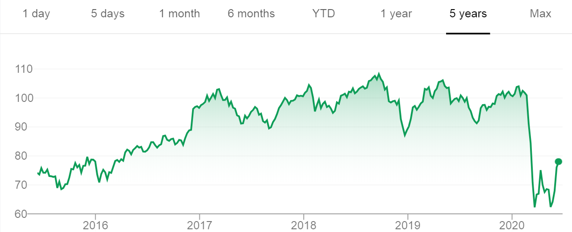
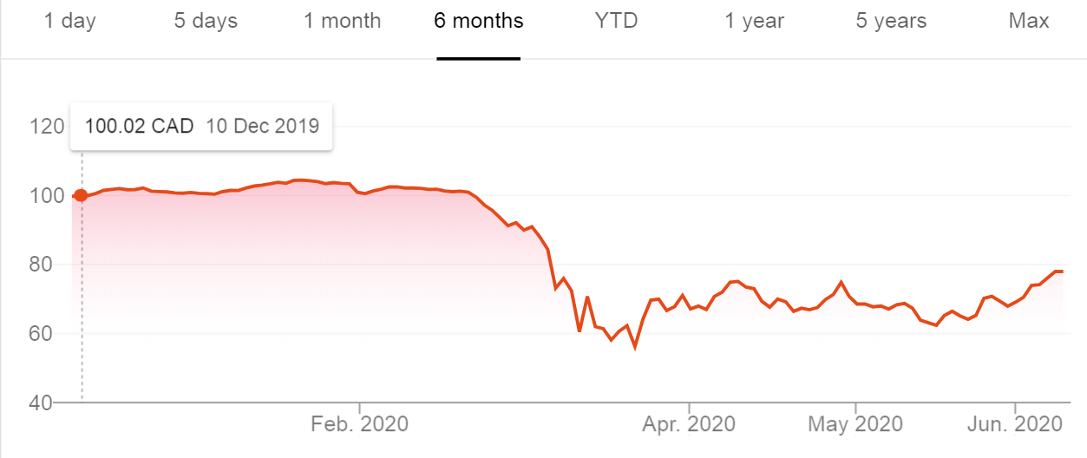

Slide 18
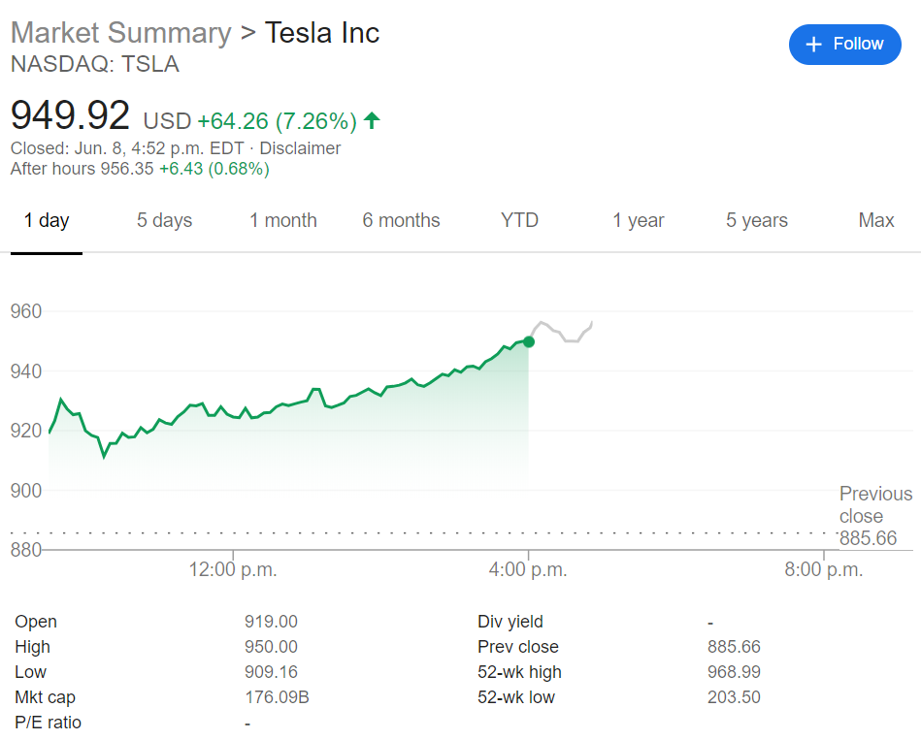
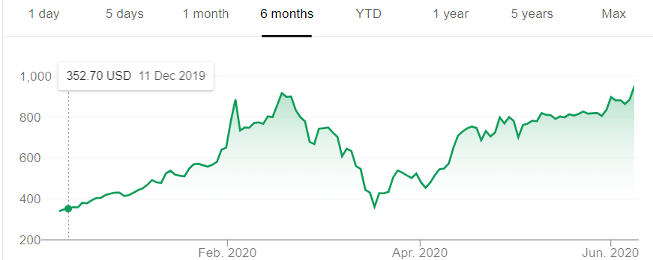
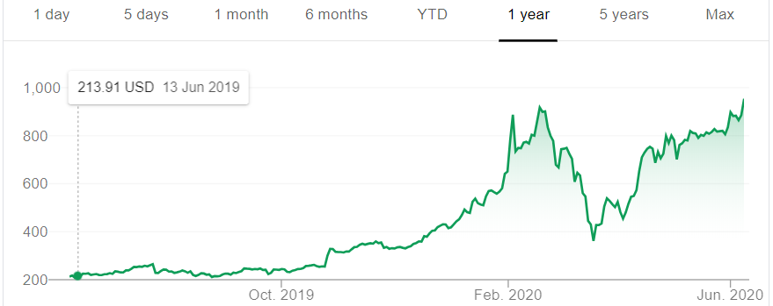
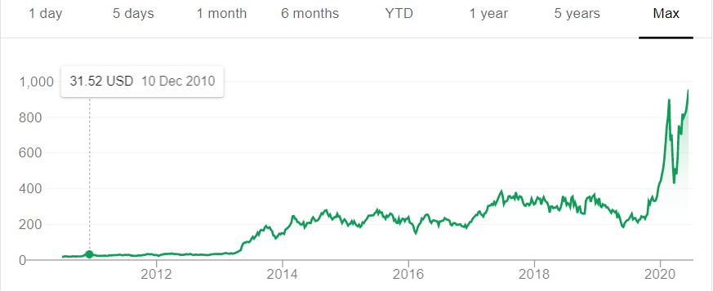

Slide 19
Summary:
Time is your most valuable asset
when you invest in a good company for a long time, your return can be many folds
“Story on Warren Buffet & Jeff Bezos”, Q: why don’t people just copy what you do?
Answer: People don’t like to get rich slow
Luck is a huge factor
Luck is the cross path of where opportunity meets skills
Be prepared, save up for when a good opportunity presents itself

Slide 20
What controls the Stock Price?
Short term affects - Bad News (world news) – OPEC (gas), Corona (Travel), Trade War, Celebrity Tweets
Financial Analyst – Motley’s Fool (Fool’s report)
Performance record from different analyst
Provides 6months to year forecast
Earnings report – a lot to read
Amount of debt a company has
Income sources, profit or loss
Popularity – long term prospect of a company/sector
Tesla, Beyond meat, Cannabis,
Short term Value of a stock can be dictated by perceptions of an investor (irrational)
In general, a Good company with good earnings will increase in stock value
Company buy backs

Slide 21
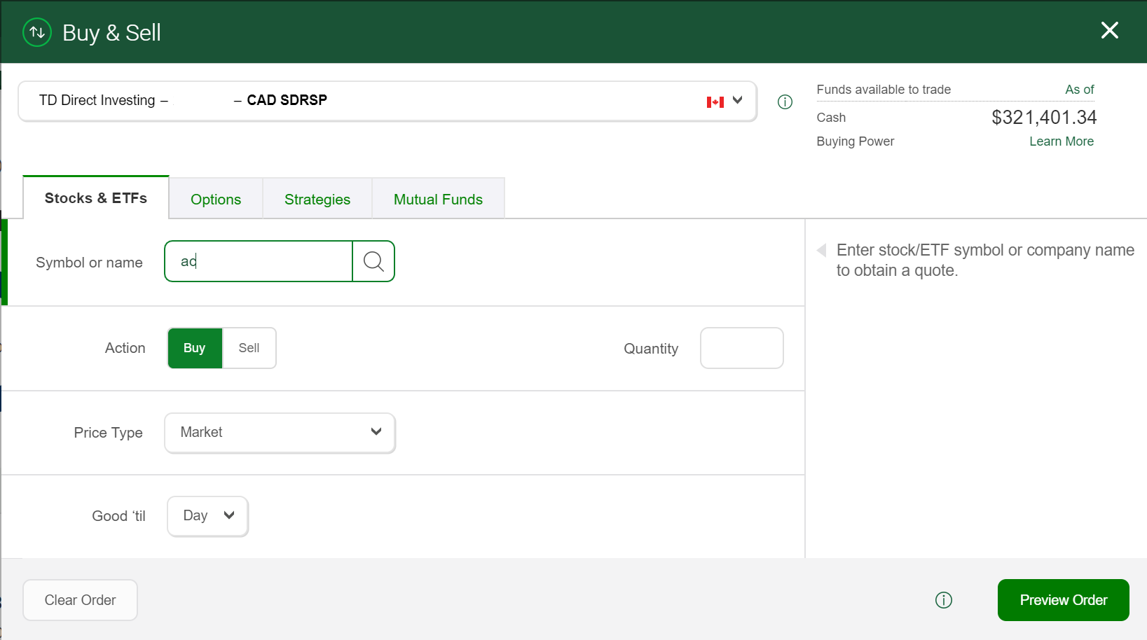
Steps on How to Buy a Stock:
1. Go to a bank and open a trading account
2. Wait 3 days for the account to be processed
3. Get Account number and online access
4. When buying a stock, you need the stock name
5. Type in how many shares and price limit

Slide 22
The Intelligent Investor: Benjamin Graham
One of the best books on the basics for beginner investors
Book (PDF)
Recommended by Warren Buffett “By far the best book on investing ever written”
Summary of the book written by someone
“Be fearful when others are greedy, and be greedy only when others are fearful.” Warren Buffett
"it's far better to buy a wonderful company at a fair price than a fair company at a wonderful price"

